Slide 1
Lesson 1
Linux Installation on Amazon Cloud
IS 340 Operating Systems

Slide 2
Agenda
What is Cloud Computing?
Six Advantages of Cloud Computing
Types of Cloud Computing
Amazon Web Services (AWS)
AWS Cloud Platform
Compute – Amazon EC2
Database – Amazon RDS
Storage – S3

Slide 3

What is Cloud Computing?
The on-demand delivery of compute power, database storage, applications, and other IT resources through a cloud services platform via the Internet with pay-as-you-go pricing (AWS. (2018). Overview of Amazon web Services)
A model for enabling ubiquitous, convenient, on-demand network access to a shared pool of configurable computing resources that can be rapidly provisioned and released with minimal management effort or service provider interaction (NIST (2011). The NIST Definition of Cloud Computing).

Slide 4
Essential Characteristics of Cloud Computing (NIST)
On-demand self-service
Broad network access
Resource pooling
Rapid elasticity
Measured service

Slide 5
Advantages of Cloud Computing (Amazon)
Trade capital expense for variable expense
Benefit from massive economies of scale
Stop guessing capacity
Increase speed and agility
Stop spending money running and maintaining data centers
Go global in minutes
More secure and compliant

Slide 6
Types of Cloud Computing
Service Models
SaaS, PaaS & IaaS
Deployment Models
NIST – Public, Hybrid, Community, & Private
Amazon – Cloud, Hybrid, & On-premises

Slide 7

Amazon Web Services (AWS)
A subsidiary of Amazon that provides on-demand cloud computing platforms to individuals, companies and governments, on a metered pay-as-you-go basis. (https://en.wikipedia.org/wiki/Amazon_Web_Services).

Slide 8
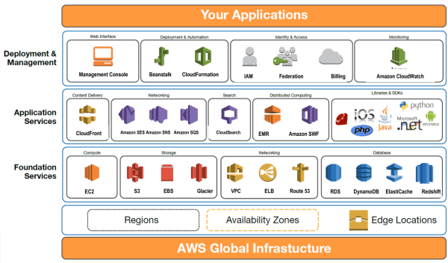
AWS Cloud Platforms
Explore Our Products. https://aws.amazon.com/

Slide 9
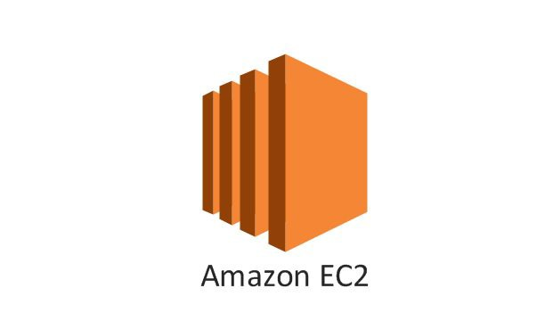
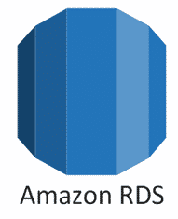
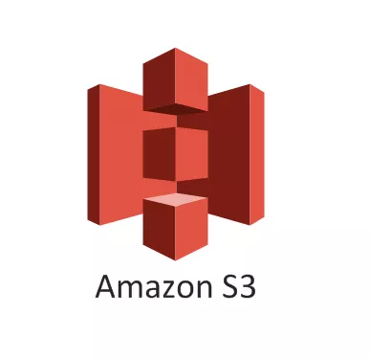
Amazon EC2
AWS Cloud Platform
Compute – Amazon EC2
Database – Amazon RDS
Storage – S3

